Slide 1

BLIND-HELP
MALATHI V
312317205077
Under the Guidance of
MR. N.RAJA MOHAMED

Slide 2
OBJECTIVE
Visually impaired people heavily rely on their other senses such as touch and auditory signals for understanding the environment around them. The act of knowing what object is in front of the blind person without touching it.

Slide 3
MOTIVATION BEHIND THE WORK
Vision plays an important part in our daily life. Humans use vision for navigating through roads, to find objects, etc. However, blind persons are not blessed with Vision which makes their life quite difficult.

Slide 4
ABSTRACT
Walking safely and confidently without any human assistance in urban or unknown environments is a difficult task for blind people. When moving from one place to another, they need help of other people around. Their independency in strolling is lost. A visually impaired person needs absolution to help him overcome problems in navigation due to his disability. The project is mainly focused on providing a type of visual aid to the visually impaired people. This project uses the mobile camera to identify objects in surroundings and gives an audio output. The hearing ability of the user tries to fulfil his seeing ability.

Slide 5
LITERATURE SURVEY
Author, Year | Title | Concept | Pros and Cons
M Afif, R Ayachi, Y Said, E Pissaloux, M Atri - Neural Processing Letters, 2020 | An evaluation of retinanet on indoor object detection for blind and visually impaired persons assistance navigation | Indoor object detection presents a computer vision task that deals with the detection of specific indoor classes. This task attracts a lot of attention, especially in the last few years | This paper uses DCNN algorithm, which is slower than YOLO algorithm. This paper detects the object which is in indoor.
M Anandan, M Manikandan, T Karthick - 2020 | Advanced Indoor and Outdoor Navigation System for Blind People Using Raspberry-Pi | Condition we focused paintings on growing supporting innovations that can assist daze people While in transit to help the outwardly debilitated all through the personality of deterrent through Raspberry pi. | This paper uses R-CNN algorithm which is also slower than YOLO algorithm. It is just a prototype not an complete implementation
5

Slide 6
A Shinde, P Bhagat, S Dhobale - 2019 | Object Detection And Recognition For Blind Assistance. | The aim of this is to explore different methods for helping computers interpret the real world visually, investigate solutions to those methods offered by the open source computer vision library | This paper is about object detection and recognition. It uses raspberry pi which a hardware need to be bought by the user.
C Luo, L Jin, Z Sun - 2019 | A multi-object rectified attention network for scene text recognition | Irregular text is widely used. However, it is considerably difficult to recognize because of its various shapes and distorted patterns. In this paper, we thus propose a multi-object rectified attention network (MORAN) for general scene text recognition. | This paper is a multi-object rectified attention network for scene text recognition which undergoes R-CNN algorithm which is slower than YOLO algorithm.
Y Jia, Y Zhang, RJ Weiss, Q Wang, J Shen - 2018 | Transfer learning from speaker verification to multispeaker text-to-speech synthesis | Deep Voice 3: 2000-speaker neural text-to-speech. In Proc. International Conference on Learning Representations (ICLR), 2018. [14] ITUT Rec. P. 800: Methods for subjective determination of transmission quality. | This project is about transfer learning from speaker verification to multispeaker text-to-speech synthesis which is not further developed.

Slide 7
SO Arık, M Chrzanowski, A Coates 2017 | Deep voice: Real-time neural text-to-speech | The connectionist temporal classification (CTC) loss function has been shown to focus on character alignments to learn a mapping between sound and text. | This project converts the text to speech which uses MFCC algorithm which is not much effective.
B Shi, X Bai, C Yao - 2016 | An end-to-end trainable neural network for image-based sequence recognition and its application to scene text recognition | A classic problem in computer vision: image-based sequence recognition. In real world, a stable of visual objects, such as scene text, handwriting and musical score, tend to occur in the form of sequence, not in isolation. | This paper is about an end to end trainable neural network for image-based sequence recognition which is not further developed for speech recognition.
S Karaoglu, JC Van Gemert, T Gevers - 2012 | Object reading: text recognition for object recognition | We propose to use text recognition to aid in visual object class recognition. To this end we first propose a new algorithm for text detection in natural images. | This paper is about text recognition after object detection which is not further developed for speech recognition.

Slide 8
SM Murtoza, F Alam, R Sultana, S Absar - 2011 | Phonetically balanced Bangla speech corpus | It needs more sentences to cover all biphones. To do that more text corpora may be required, Speech recognition application requires more recording data in different environments which includes recording the voice by huge number (>50) of male and female voice talents | This project converts the text to speech which uses LPCC algorithm which is not much effective and not further developed for future use.
L Dunai, GP Fajarnes, VS Praderas - IECON 2010 | Real time assistance prototype - a new navigation aid for blind people | This paper presents a new prototype for being used as a travel aid for blind people. The system is developed to complement traditional navigation systems such as white cane and guide dogs | This paper uses R-CNN algorithm which is also slower than YOLO algorithm. It is just a prototype not an complete implementation.

Slide 9
SUMMARY OF LITRATURE SURVEY
A propose an assistive system to help blind persons read using the OCR algorithm. This system is in the form of a glove and smart glasses with camera embedded index that can be worn by the blind user.
An assistive system to help blind users. Their system makes use of Raspberry Pi, which is an embedded computer for processing text present in the images.

Slide 10
DRAWBACKS OF EXISTING SYSTEM
The existing system uses Raspberry Pi and smart glasses as a navigation system which is a external hardware need to be brought.
Many voice based systems such as voice based e-mail, voice based mobile features etc. which doesn’t detect any objects.
The other systems focus only on internal objects and not on external objects.

Slide 11
PROPOSED WORK
In our system, the blind person will hold the mobile phone in their hand while navigating through the streets while the application is running.
The application will identify the objects present in the frame and announce the name of the object detected in the form of audio through headphones worn by the blind user.
The audio announcement consists of the name of the object as well the distance.

Slide 12




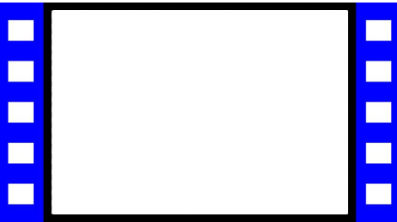

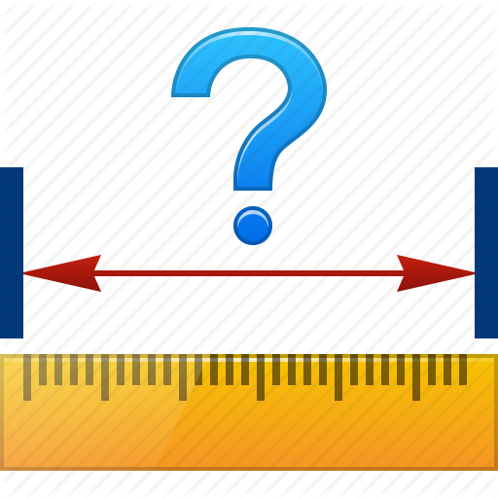

ARCHITECTURE DIAGRAM
Capturing live video
Input image
Dividing into regions
Detect object
Object Classification
Object detection
Video converted to frame of images
Reading Input image
Object name with distance
Distance measurement
Output voice

Slide 13
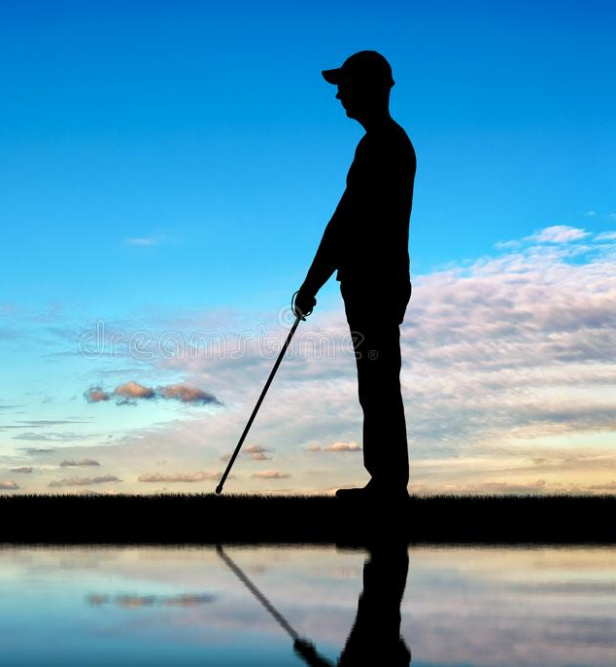
LIST OF MODULES
1. Reading input image 2. Object detection 3. Object classification 4. Distance calculation 5. Output voice

Slide 14
READING INPUT IMAGE
This module basically performs two major steps,
Capturing live video
Converting video to frames
The live video will be captured from the camera hold by the user. Capturing live video will be converted to numerous numbers of frames. Those frames will be given as input sequence.

Slide 15
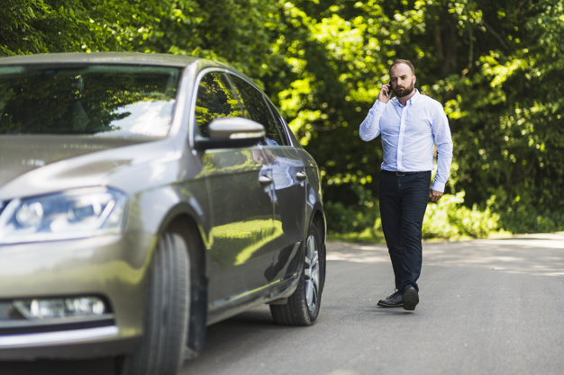
OBJECT DETECTION
With the obtained input from the above module, we proceed with the next module called object detection. The steps involved in object detection are,
1. First, we take an image as input
15
15

Slide 16
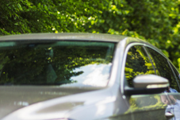

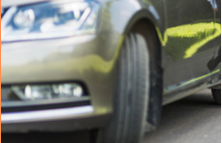
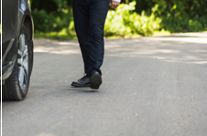
2. Then we divide the image into various regions
3. We will then consider each region as a separate image.

Slide 17
4. Pass all these regions to the YOLO algorithm and classify them into various classes.
5. Combine all these regions to get the original image with the detected objects

Slide 18
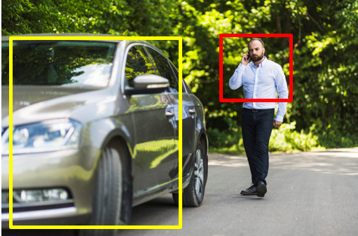
OBJECT CLASSIFICATION
Object Classification is a classification problem which tends to classify different objects which could be flowers, faces, fruits or any object we could imagine. All the detected objects from the above module will be classified under COCO dataset.
PERSON
CAR
18
18

Slide 19
DISTANCE CALCULATION
The distance between the object and the user will be
calculated in this module. Here the distance is calculated in inches.
x = boundingboxes[0] w = boundingboxes[2]
y = boundingboxes[1] h = boundingboxes[3]
distance = ((2 * 3.14 * 180) / (w.item() + h.item() * 360) * 1000 + 3)
19
19

Slide 20
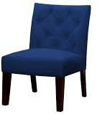
Distance
Object
Screen
Object near to screen
Distance
Object
Object away from screen
Screen
20

Slide 21
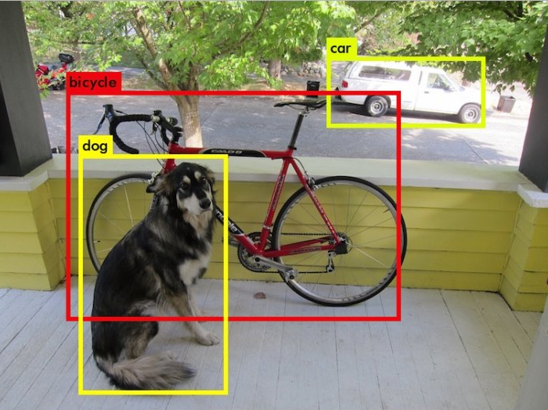

OUTPUT VOICE
In this module the speech will be the output. The obtained distance and classified objects will be converted to speech. Pyaudio is used for the conversion of text to speech.
Object identified with name distance
21
21

Slide 22
REFRENCES
[1] “Wearable technology,” Nov 2019. [Online]. Available: https://en.wikipedia.org/ wiki/Wearable technology
[2] J. Hui, “What do we learn from single shot object detectors (ssd, yolov3), fpn & focal loss (retinanet)?” Medium [Online]. Available: [Accessed:, vol. 28, September 2019.
[3] C.-Y. Cao, J.-C. Zheng, Y.-Q. Huang, J. Liu, and C.-F. Yang, “Investigation of a Promoted You Only Look Once Algorithm and Its Application in Traffic Flow Monitoring,” Applied Sciences, vol. 9, no. 17, p. 3619, 2019.
[4] Z. Zhang, T. He, H. Zhang, Z. Zhang, J. Xie, and M. Li, “Bag of Freebies for Training Object Detection Neural Networks,” arXiv:1902.04103 [cs], 2019.
22
22

Slide 23
[5] B. Benjdira, T. Khursheed, A. Koubaa, A. Ammar, and K. Ouni, “Car Detection using Unmanned Aerial Vehicles: Comparison between Faster R-CNN and YOLOv3.” IEEE, 2019, pp. 1–6.
[6] A. I. Maqueda, A. Loquercio, G. Gallego, N. Garc´ıa, and D. Scaramuzza, “Eventbased vision meets deep learning on steering prediction for self-driving cars,” in 2018 IEEE/CVF Conference on Computer Vision and Pattern Recognition, June 2018, pp. 5419–5427.
[7] A. Wong, M. J. Shafiee, F. Li, and B. Chwyl, “Tiny SSD: A Tiny Single-shot Detection Deep Convolutional Neural Network for Real-time Embedded Object Detection,” arXiv:1802.06488 [cs], 2018.
23
23

Slide 24
[8] K.-J. Kim, P.-K. Kim, Y.-S. Chung, and D.-H. Choi, “Performance Enhancement of YOLOv3 by Adding Prediction Layers with Spatial Pyramid Pooling for Vehicle Detection,” 2018, pp. 1–6.
[9] P. Maolanon and K. Sukvichai, “Development of a Wearable Household Objects Finder and Localizer Device Using CNNs on Raspberry Pi 3,” 2018, pp. 25–28.
[10] M. B. Jensen, K. Nasrollahi, and T. B. Moeslund, “Evaluating State-of-the-Art Object Detector on Challenging Traffic Light Data,” 2017, pp. 882–888.
24
24

Slide 25
THANK YOU

